Slide 1


Origins of Dragons
A literature Review by : Coryden Spencer

Slide 2
Thesis
The cross-cultural prevalence of dragons is best understood not as the result of a single origin, but as the intersection of evolutionary cognition, environmental influences, symbolic systems, and historical interactions, demonstrating the need for a multi-framework anthropological approach to myth analysis.
Research Questions
How do Scholars explain the cross-cultural emergency of dragons?
What do these explanations say about the human relationship to the how humans perceive the world around us?

Slide 3
Methodology
Conduct a cross cultural analysis of four individual cultures
  Western Europe
  The Mediterranean
  East Asia
  Mesoamerica
Gather as much as I can and Identify the Biases within them

Slide 4
Analysis Frameworks
Cognitive
Symbology
The structural parts of society that built the connection
The Evolutionary Psychology behind it
Ecology
Diffusion
The environment around that shapes how people see the world
The interconnectivity between cultures

Slide 5
01
Cognitive
The Psychological Approach
Notes:
Remember to warn about images of reptiles and snakes fallowing, for those who cannot look at them for cultural reasons.

Slide 6
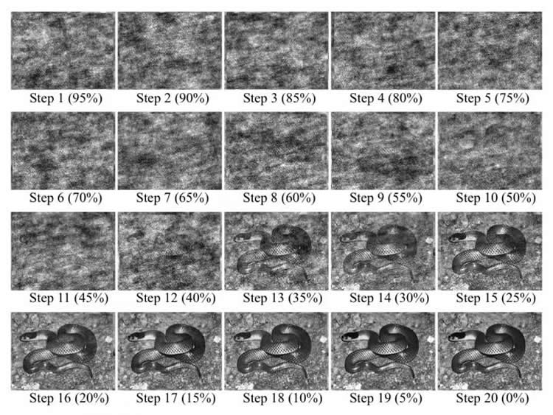
Psychology
“Predator Template” (Jones 2002)
  Cognitive Universal
  Cultural Combination of snakes, raptors, and large carnivores
Humans’ natural aptitude for detecting snakes (Kawai, Nobuki, and Hongshen He. 2016)
Notes:
Jones = An Instinct of Species
Kawai, Nobuki, and Hongshen He. 2016 =

Slide 7
02
Ecology
The environment around people shaping their view

Slide 8
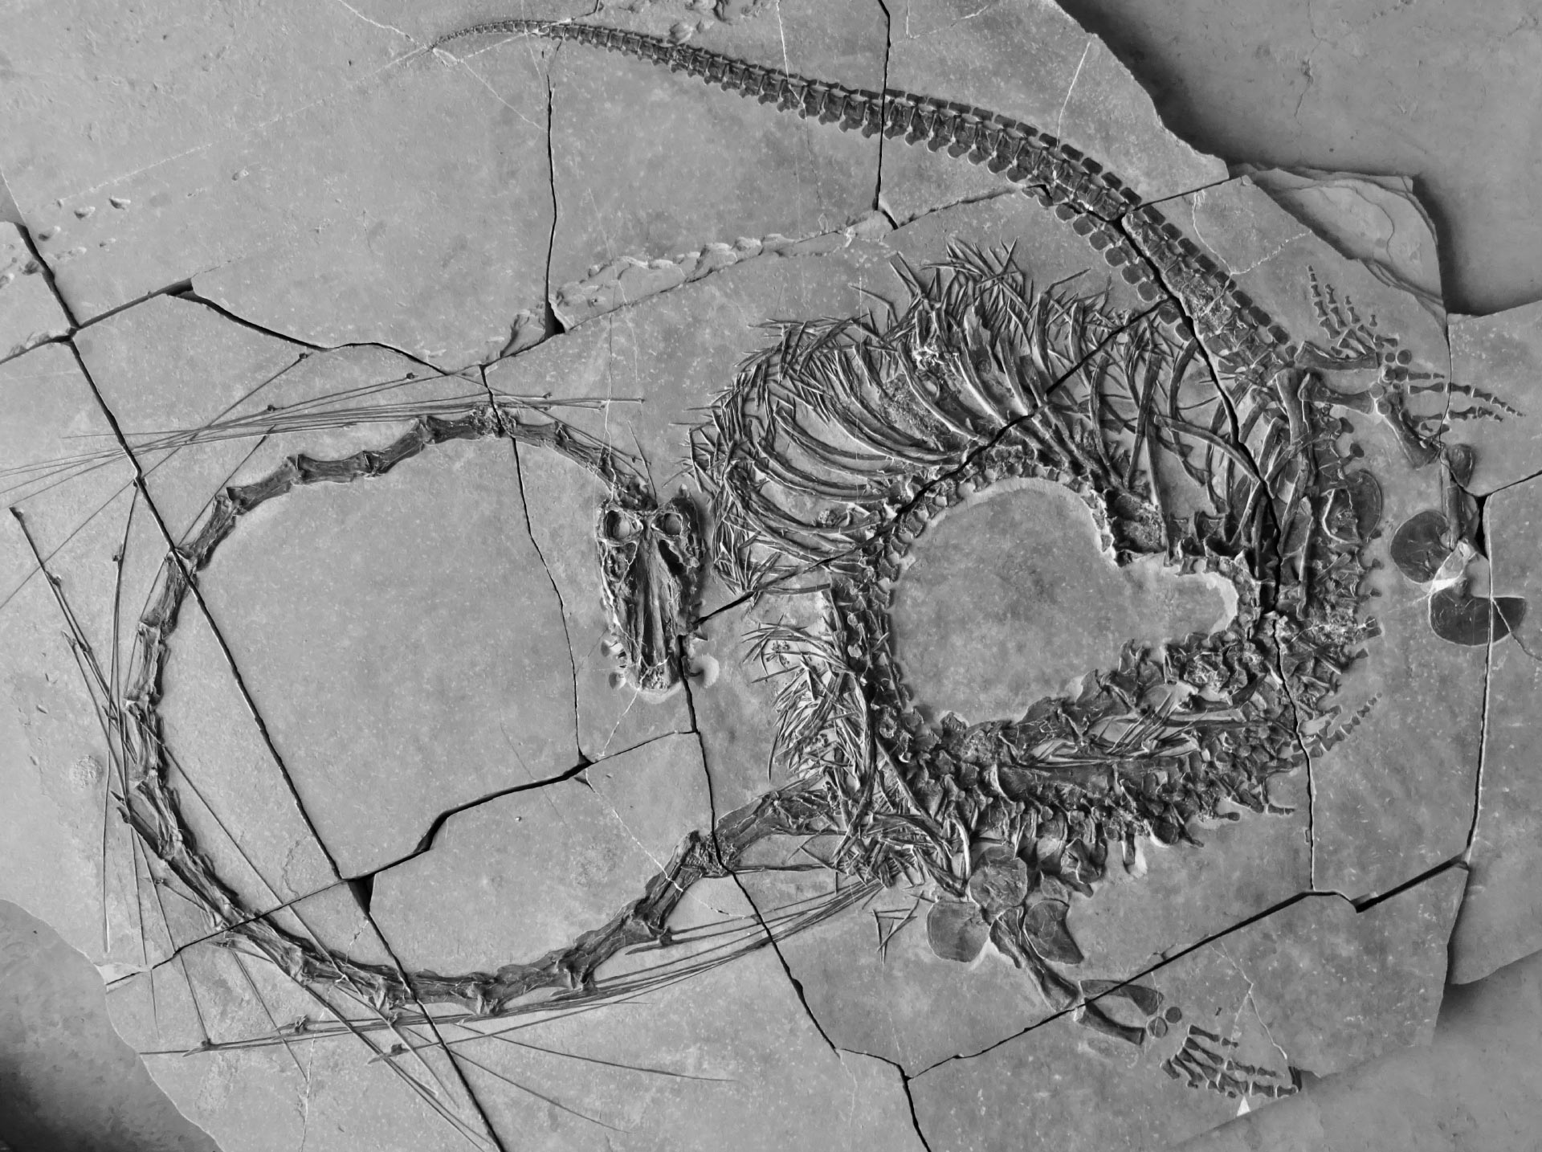
Fossils
Finding Fossils for most of our history, but not knowing what they were
Dinocephalosaurus orientalis found off the coast of southwestern China in 2003 (Spikeman, Stephan N.F., Wang, Wei, Zhao, Lijun, Rieppel, Oliver, Fraser, Nicholas C. and Li, Chun. 2024.)
Notes:
Jones = An Instinct of Species
Kawai, Nobuki, and Hongshen He. 2016 =

Slide 9
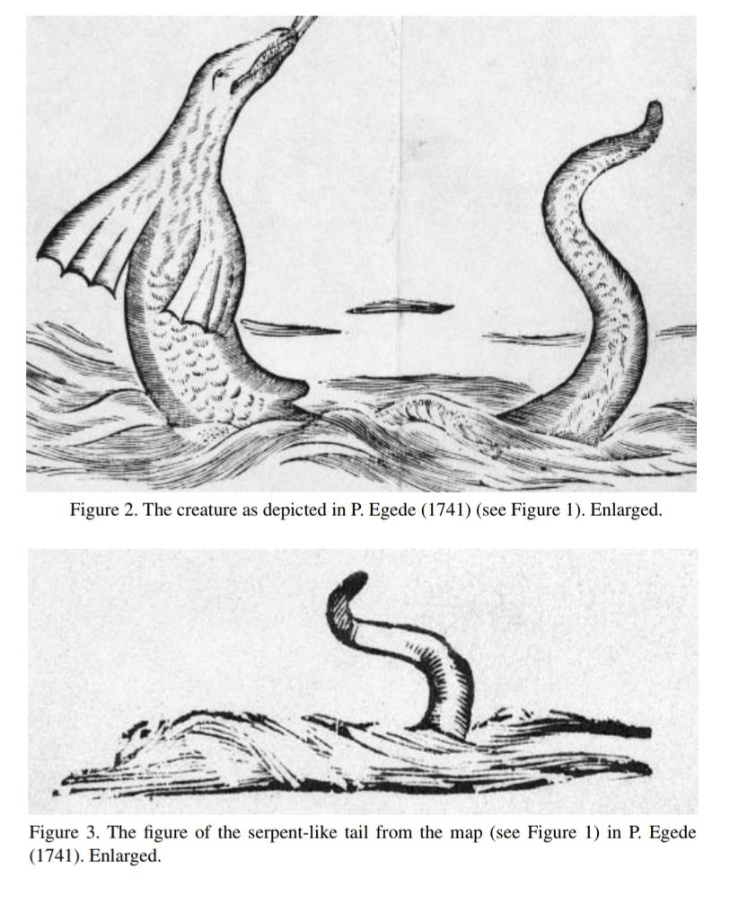

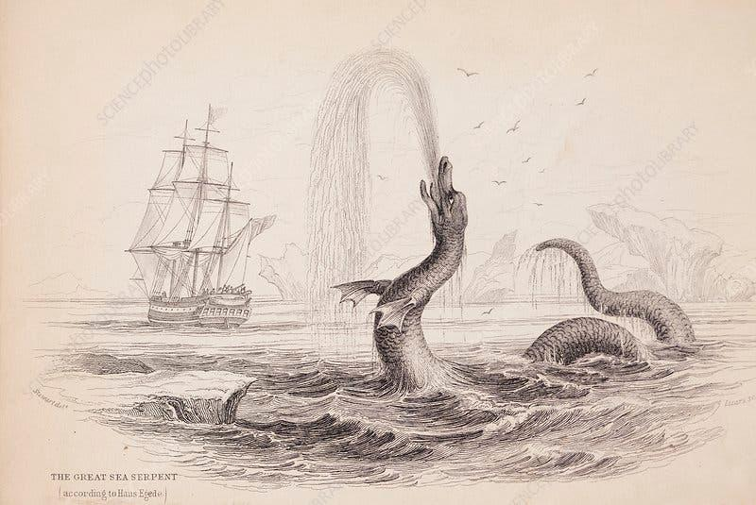
Living Animals
Mediterranean sea serpent sightings most likely being whale penises (Jones 2002)
Mesoamerican Amphitheres being chaotic sightings of rows of birds through canopy’s
Notes:
Jones = An Instinct of Species
Kawai, Nobuki, and Hongshen He. 2016 =

Slide 10
03
Symbology
The cultural components that shape a society's worldview

Slide 11

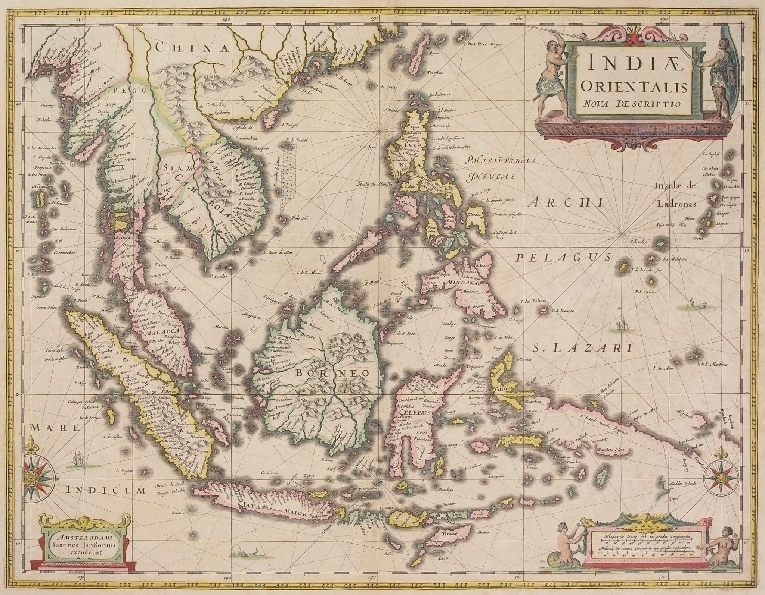
Cultural Dichotomy
Western Europe
Eastern Asia
In Medieval Europe, Dragons were paragons of sin, representing nature’s wrath and social chaos
(Kahlifa-Gueta 2018)
In China, Dragons were representations of Empyreal Power, and Symbols of Harmony
(Zhang 2024)

Slide 12
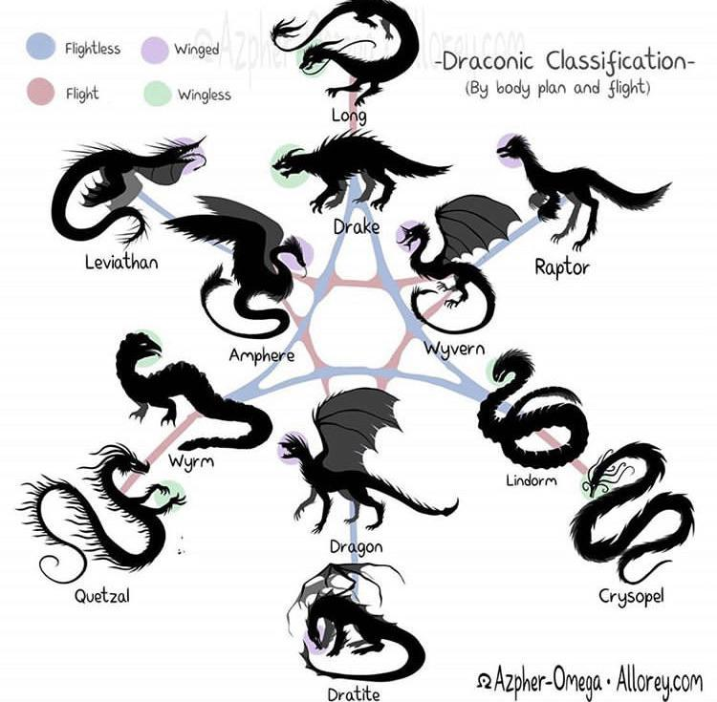
Explanations for the world
In Japan, dragons are closely associated with storms and water (Izotova, 2024)
In the Mediterranean the sea serpents were associated with chaotic waters (Núñez et al., 2015)
In Mesoamerica, amphitheres are associated with winds and crop fertility (Jones 2002)
Notes:
Jones = An Instinct of Species
Kawai, Nobuki, and Hongshen He. 2016 =

Slide 13
04
Diffusion
The Cultural Diffusionist approach

Slide 14
Cultural Diffusion
The spread of artifacts, knowledge, and ideas between people among different cultures, which then spreads and gets integrated into the culture of origin
Posits that the spread of dragons and their similarities follow contact points, and trade roots
  The Mediterranean serpent myths are consistent with the exchanges that had been taking place between the Near East, North Africa, and Southern Europe (Kahlifa-Gueta 2018)

Slide 15
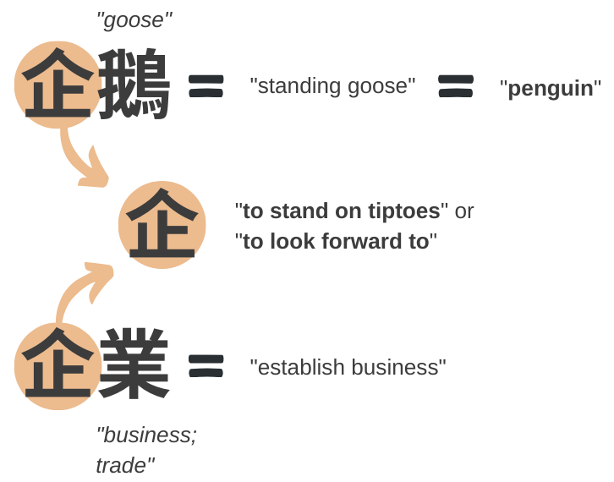
Language Translation
Language translation is not an exact ‘science’ (Luo, Ni 2002)
Semantic Translation
  Tries to keep the syntactic structures of the second, to allow for an exact translation of the original
Communicative Translation
  Takes in the whole message of what’s being said, and presents it in the way the second language understands
Notes:
Jones = An Instinct of Species
Kawai, Nobuki, and Hongshen He. 2016 =

Slide 16
Which is it?

Slide 17
Significance
A case study in how similar phenomonea can origionate cross-culturally

Slide 18
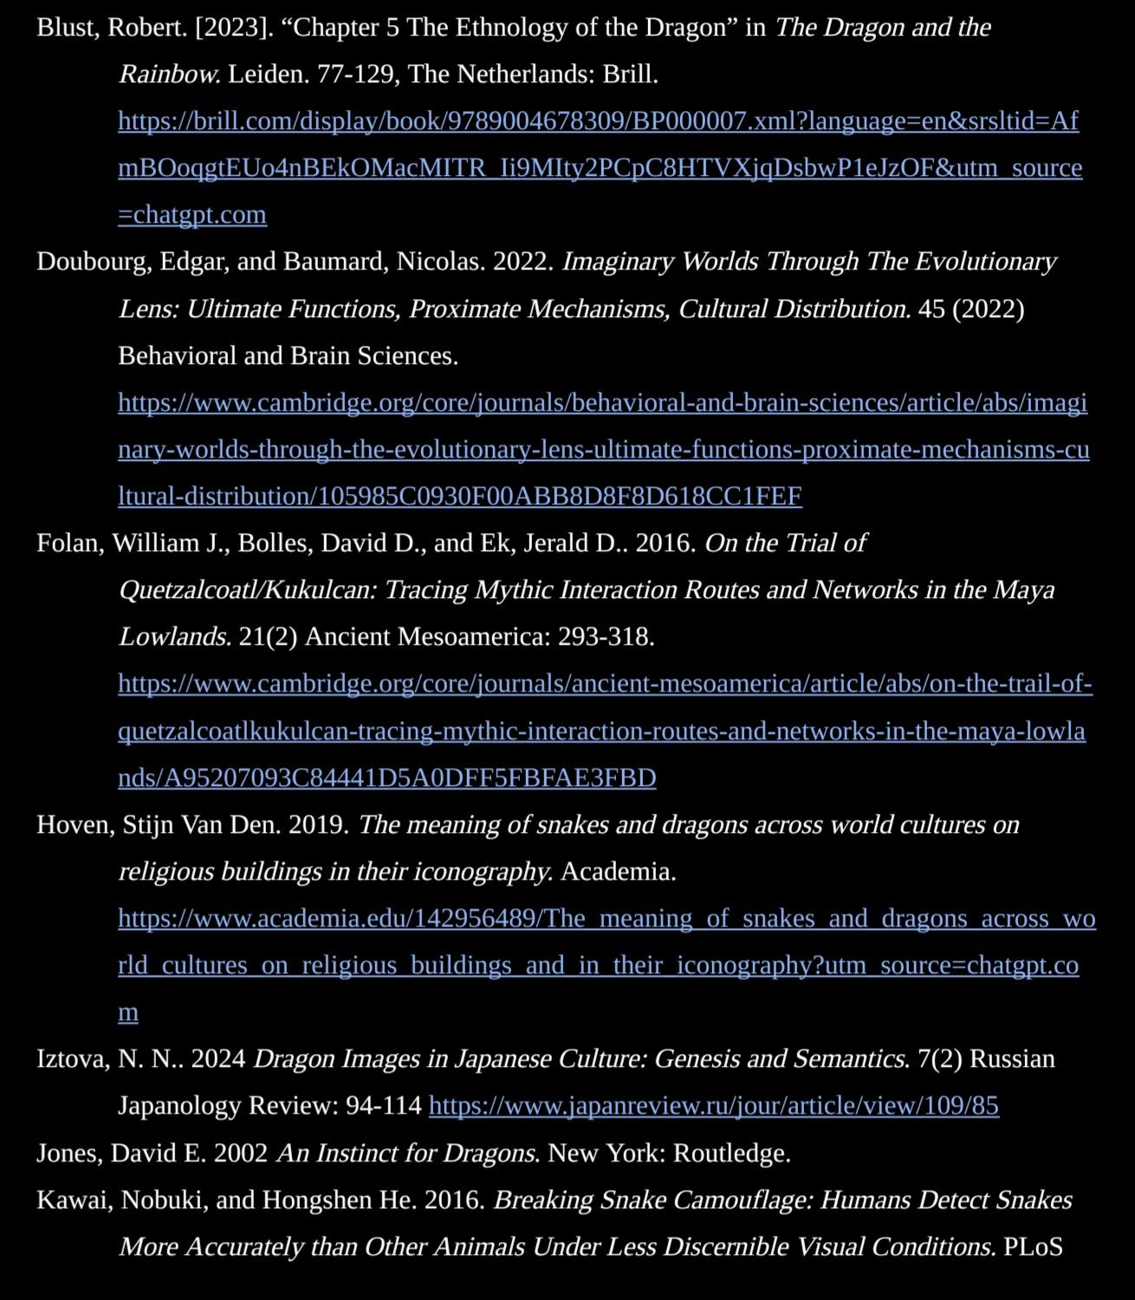
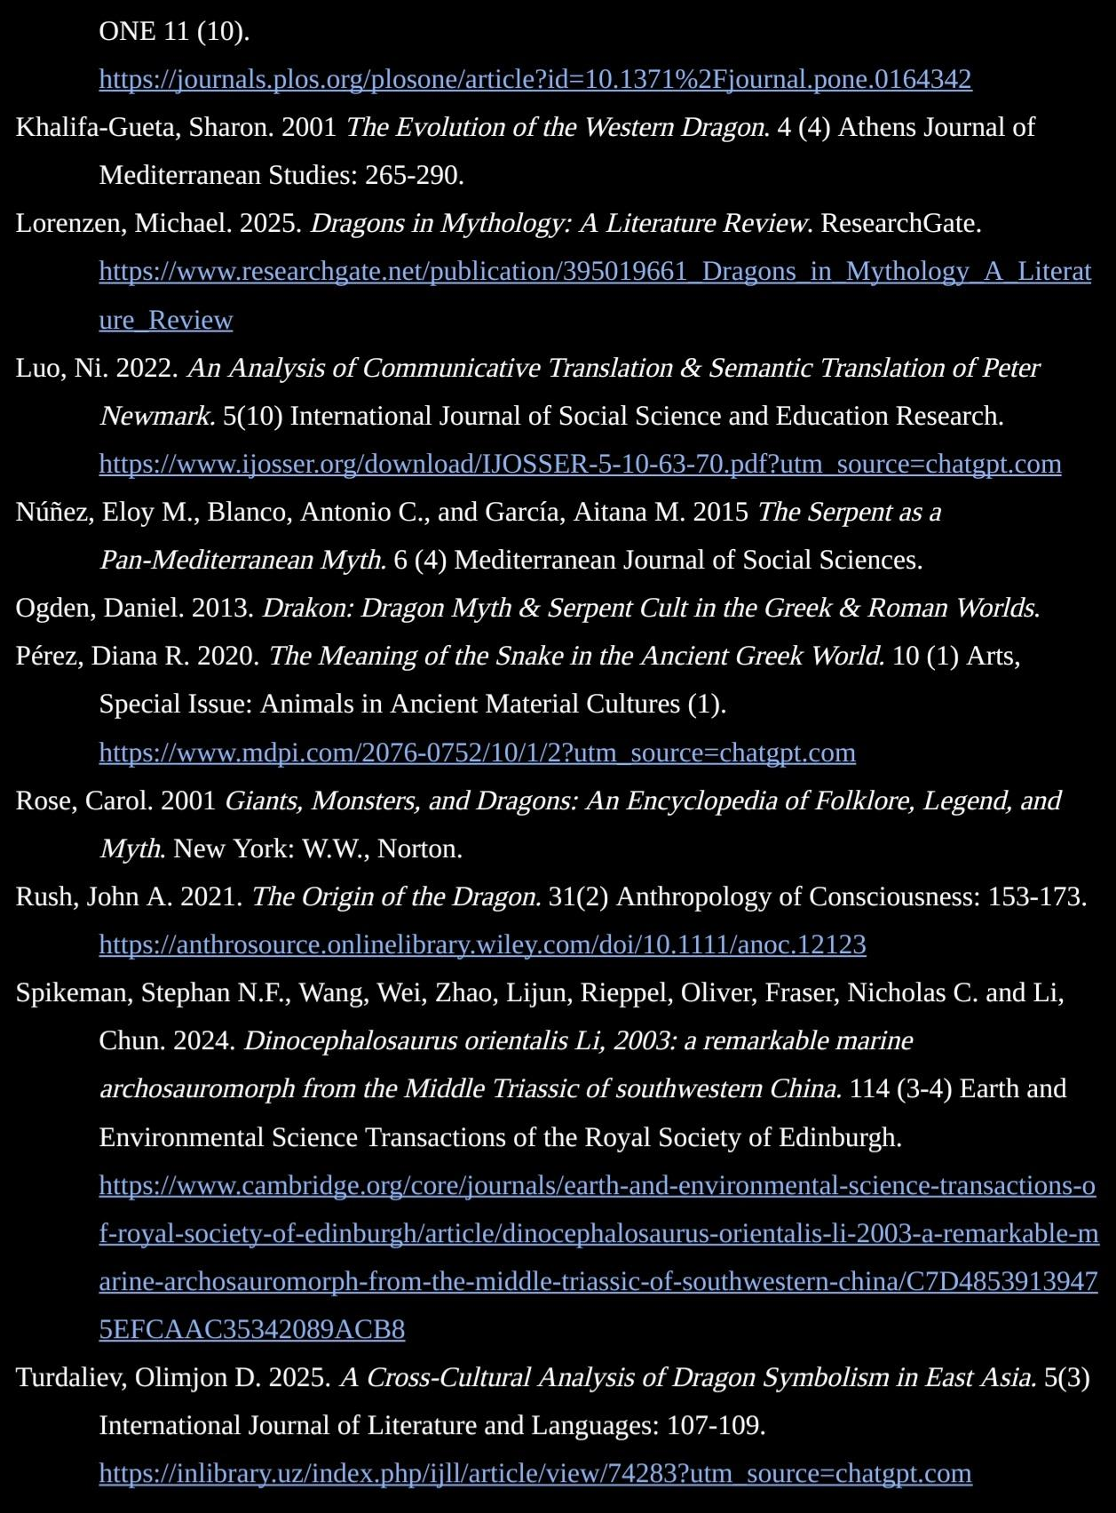
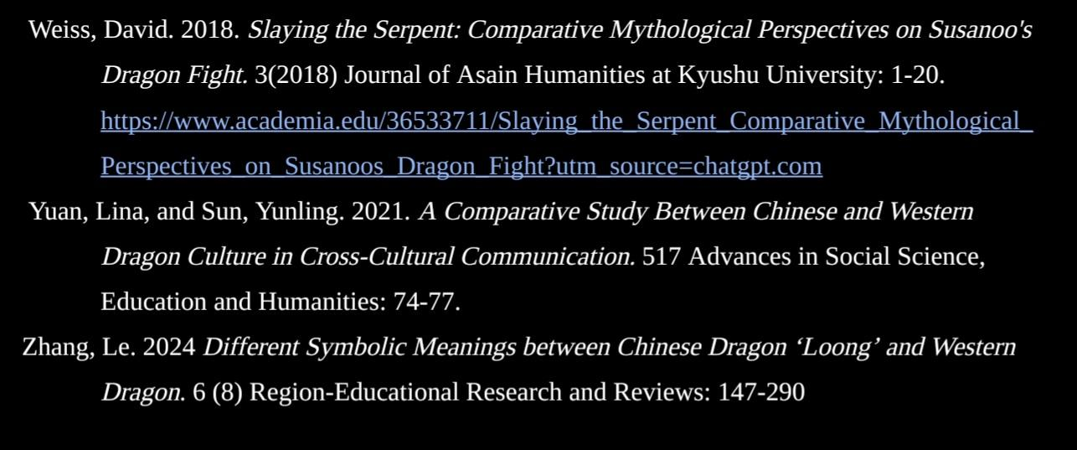
RESOURCES

